Slide 1
WHEN WILL IT BE SPRING QUESTIONS

Slide 2
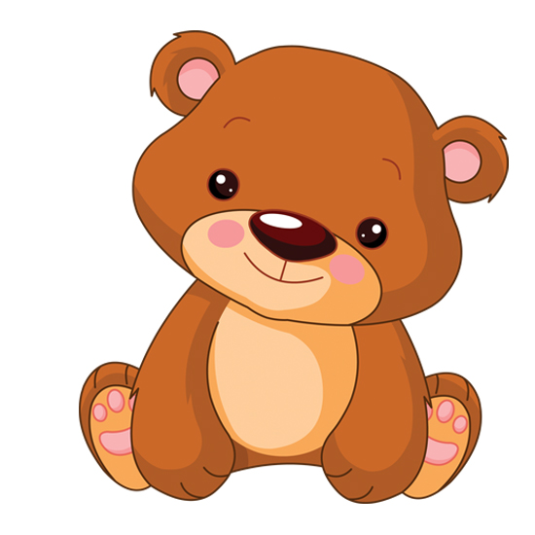
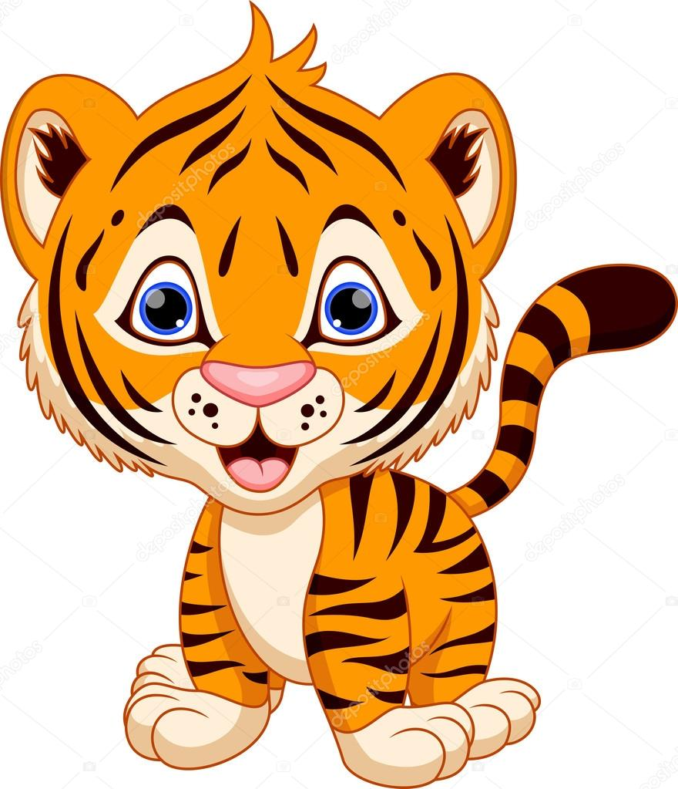
What animal is Alphie?
A bear
A tiger

Slide 3
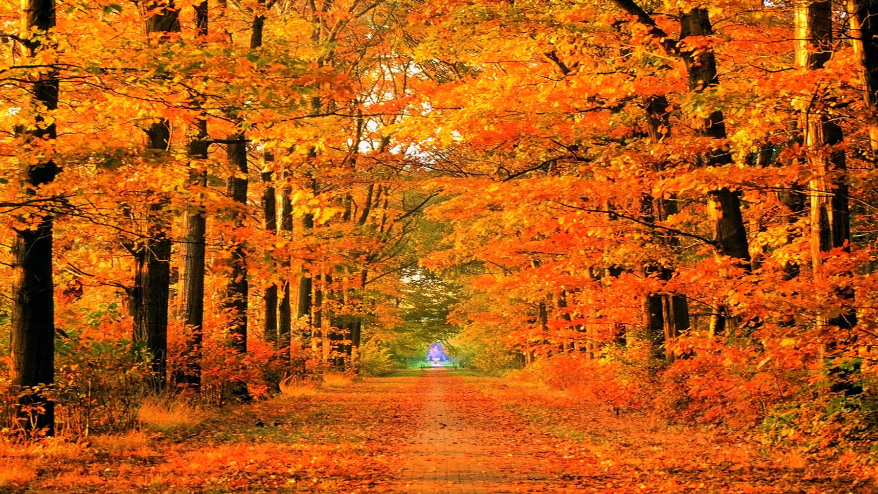
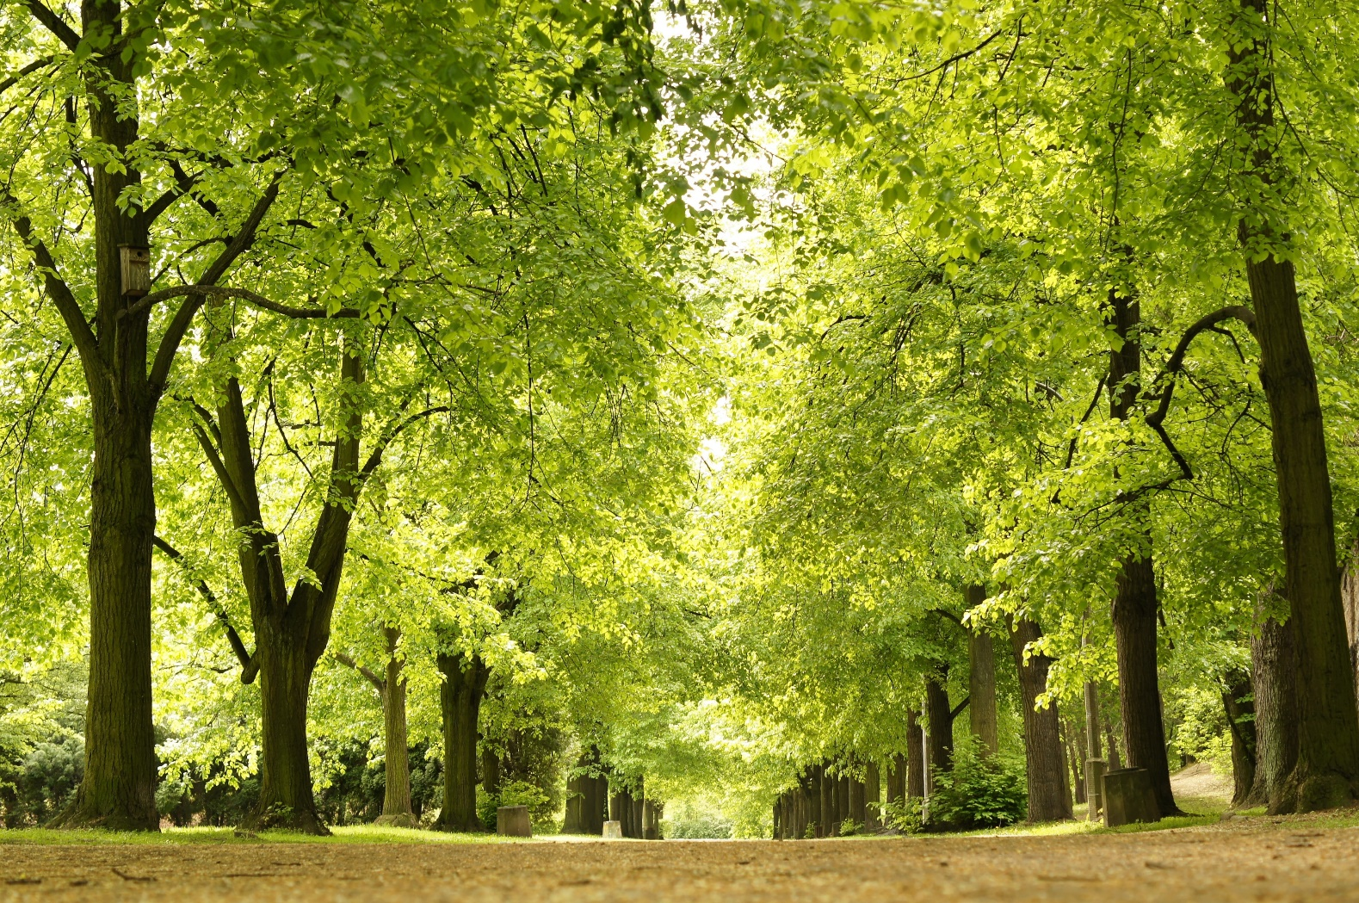
What season is it?
Fall
Spring

